Slide 1

1
Department of Computer Science and Engineering
North Western University
Course Code:CSE-3206
Course Title: Computer Networks Sessional
Apartment Network
Submitted By:
Name: Zarin Hossain Sheetal
ID:20183032010
3rd Year 2ndSemester
Department of Computer Science and Engineering
North Western University,
Khulna
Submitted To:
M. Raihan
Lecturer,
Department of Computer Science and Engineering
North Western University,
Khulna

Slide 2
Content
2
In this presentation I will give description about of this networks-
Design description,
Procedures,
Elements description.

Slide 3
Introduction
3
This design describes a sample Apartment network made by Cisco Packet Tracer.
This is a simple demonstration of a test network design.
It is properly configured network devices.
Here I will discuss about this sample network.

Slide 4
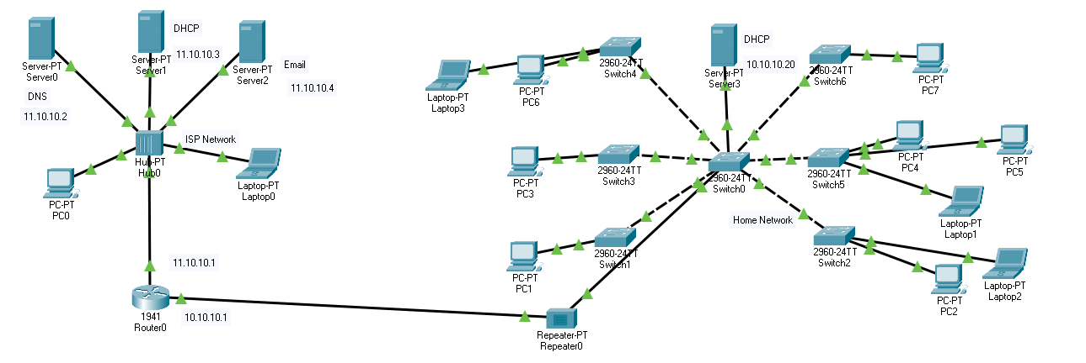
Design:
4
Here is the screenshot of the design overview.

Slide 5
Design description:
5
This design describes an Apartment network layout.
This design contains several networks to connected.
This contains several elements to provide necessary network connections
Such are router, switches, hubs, repeaters, servers.
There are several LANs in this network design.
All LANs are interconnected via switches, hub or router.

Slide 6
Design description:
6
This design have these internal networks:
ISP Network :
Containing 3 servers with 1PC and 1 Laptop and 1 hub.
Home Network :
Containing 1 Server.
1 central switch
6 branch/floor switches
Every branch switches have 1 or more PCs/laptops.
These internal networks interconnected through the ISP network though 1 router.
That router is connected home network though repeater for resolving long distance signal loss.

Slide 7
Procedures
7
There are total 1 router, 7 switches, 1 hub, 1 repeater and 4 servers used.
At the end devices, there are total 8 PCs, 4 laptops used.
The central router is interconnect all other internal/LAN network together.
The 1 hub connected with ISP network.
Many networks are connected through switch. Such are, Central home network, Branches of home network.
Inside ISP network, there are 3 servers, 1 PC and 1 laptop connected.
1 repeater used for connecting Home network to ISP network for maintaining optimally for longer distance network.

Slide 8
Procedures
8
The 3 types of servers used for these purpose:
DHCP Server:
For creating dynamic network in 1 PC and 1 laptop inside ISP network and home network.
Mail Server:
This server used for mail communication inside of the whole network.
DNS Server:
This server used for Domain Name Service for their web site and mail service.

Slide 9
Elements Description
9
Router:
This type of device is in network layer.
This device use for connect different network.
This device use for MANs, District based network, Internet.
It can use various routing protocols.
Router use full duplex.
Switch:
This type of device is in data layer.
This devices use for connecting high number of devices through a lot of ports.
It uses for LAN network.
It uses full and half duplex mode.

Slide 10
Elements Description
10
Hub:
This device use in physical layer.
This device use case is for LAN network.
This device does not support huge connection at a time.
Hub use half duplex mode.
Repeater:
This type of device in physical layer.
Repeater regenerates signal, it does not amplify signal.
It provides long device connection optimally.
It connect 2 devices though long distance due to repeating signal in between long distance connection.

Slide 11
Elements Description
11
Server:
This is an end device.
It does serve specific functions
Such are DHCP, DNS, Email Service etc.
PC:
This is also an end device.
It connects with wire.
One of the device that user directly interact.
It can browser the web, email some other computer etc.

Slide 12
Elements Description
12
Laptop:
This is also an end device.
Its purpose is same as PC.

Slide 13
Conclusion
13
In this presentation, we now get proper description of sample Apartment network design.
This simple network design demonstrate some common network practice in packet tracer.
We can learn some technology throughout this network design.

Slide 14

14

